Slide 1


Slide 2

Founded in 2009
  23 Founding Members
  ~1000 Members Worldwide
  31 Life Members
  4 Honorary Members
  ~500 Student Members
Introduce Members Attending

Slide 3
11-Year Anniversary of the FMA Solo Program
  ~300 Nominees – All onboarded as Student Members
  18 scholarship recipients
Mentor's Ramp
  Open to All Members
Ambassadors

Slide 4
2015
2016

Slide 5
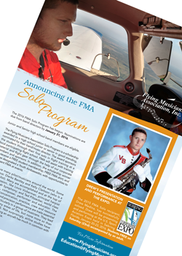
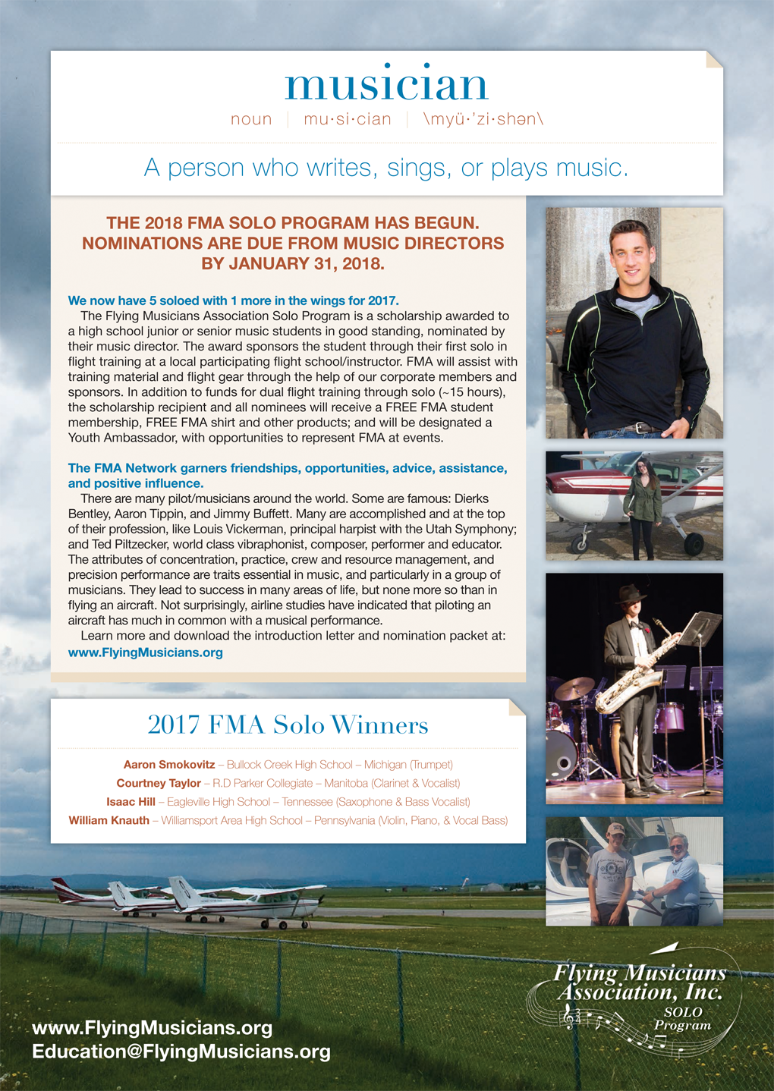
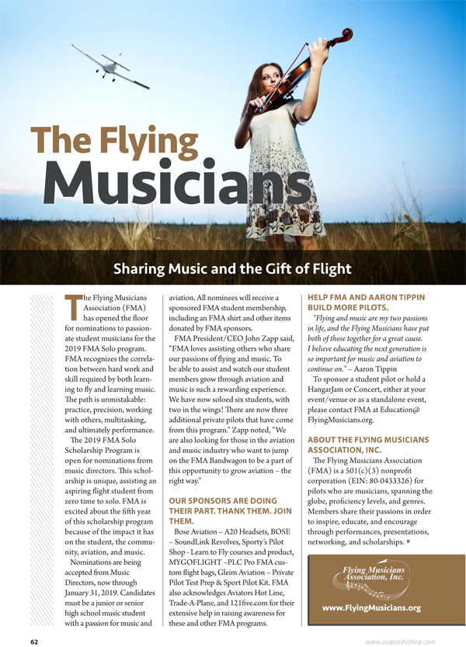
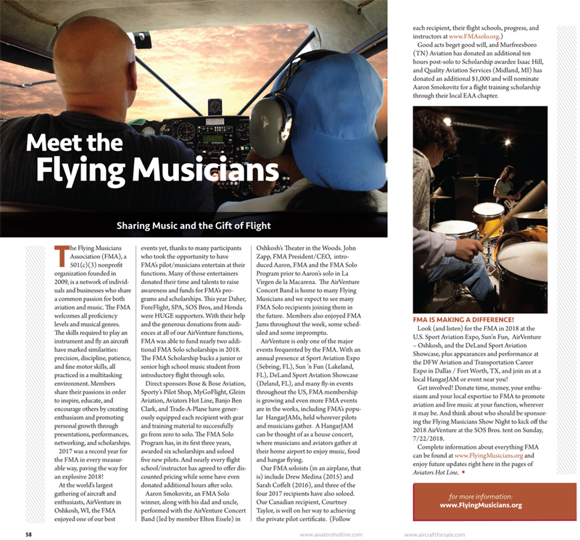
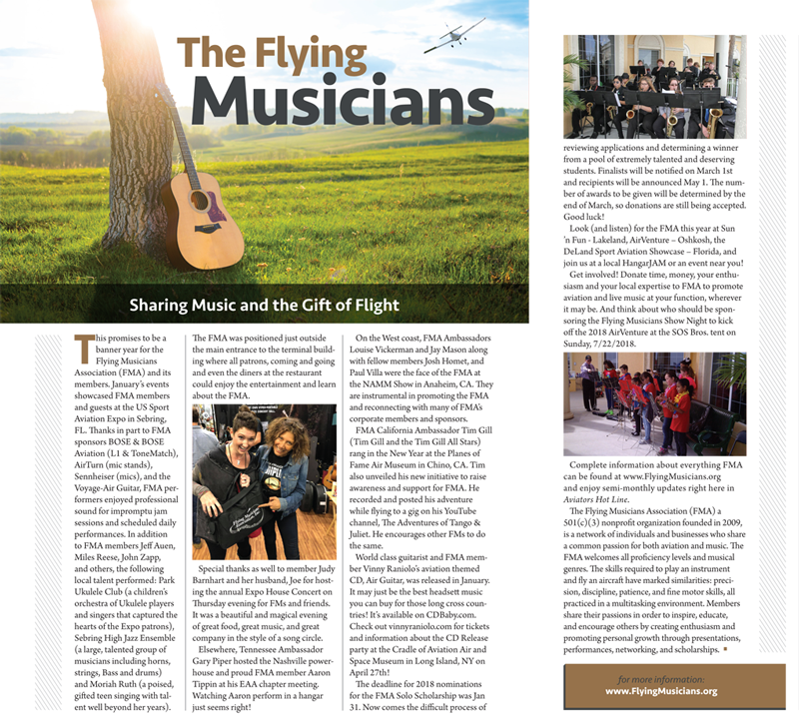

Slide 6
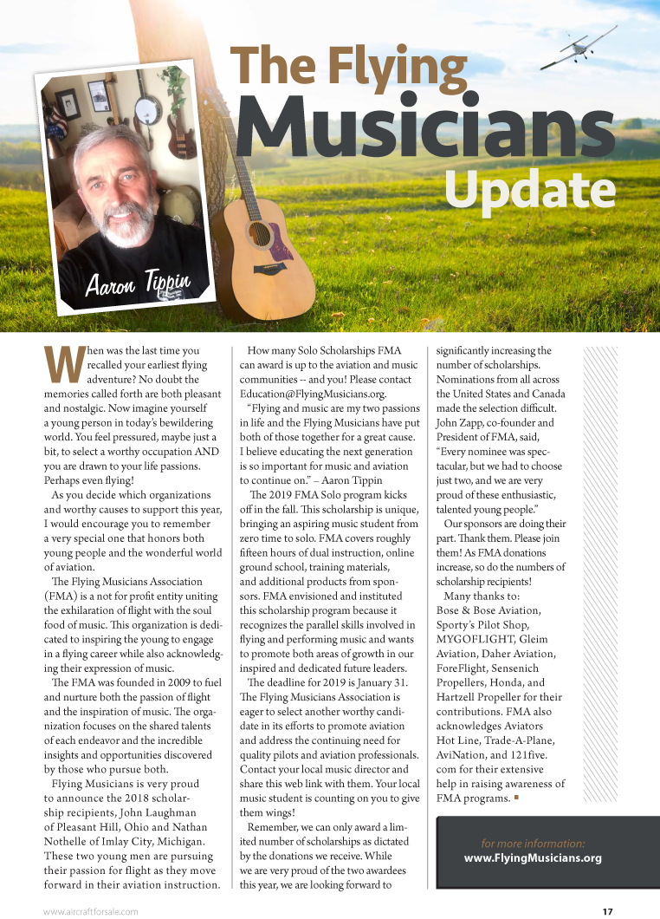
“Flying and music are my two passions in life and the flying musicians have put both of those together for a great cause. I believe educating the next generation is so important for music and aviation to continue on.”
– Aaron Tippin

Slide 7
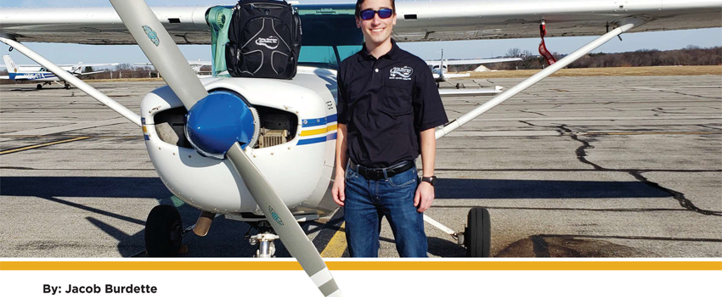
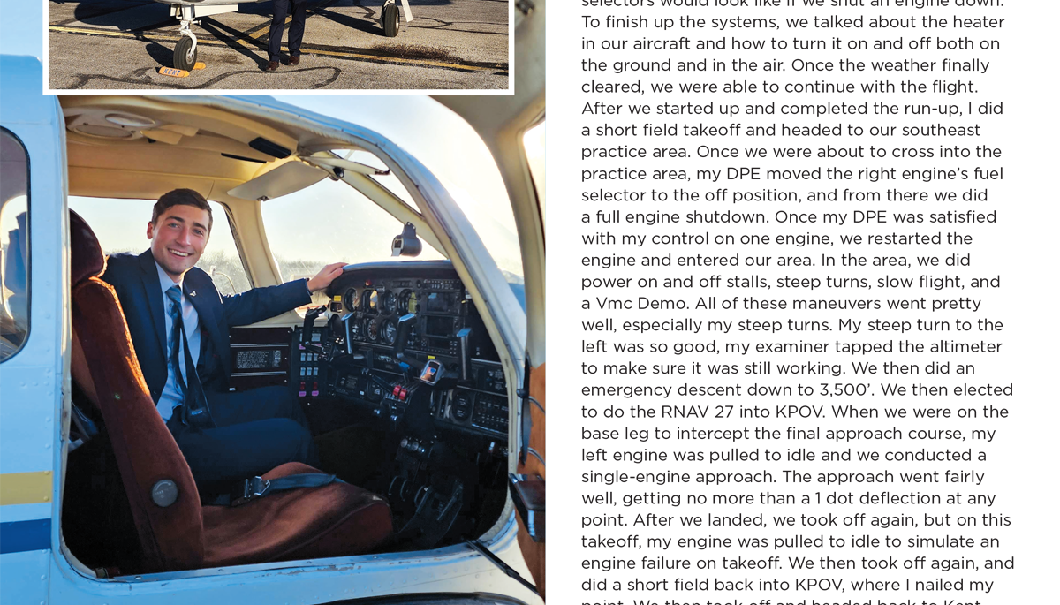
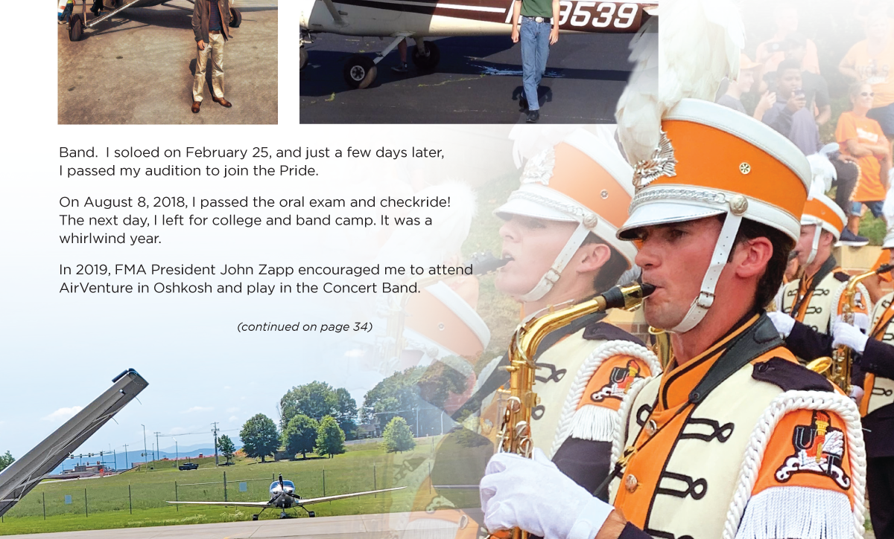
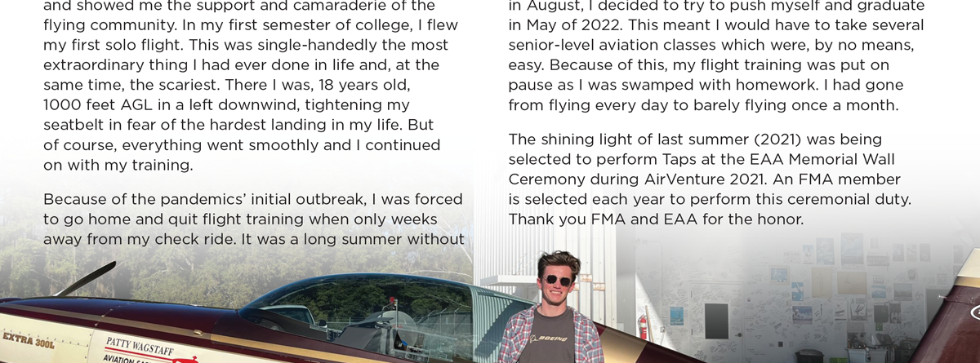

Slide 8
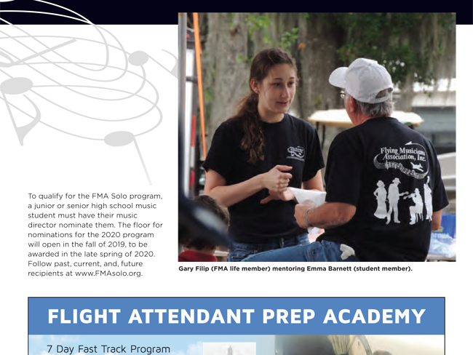
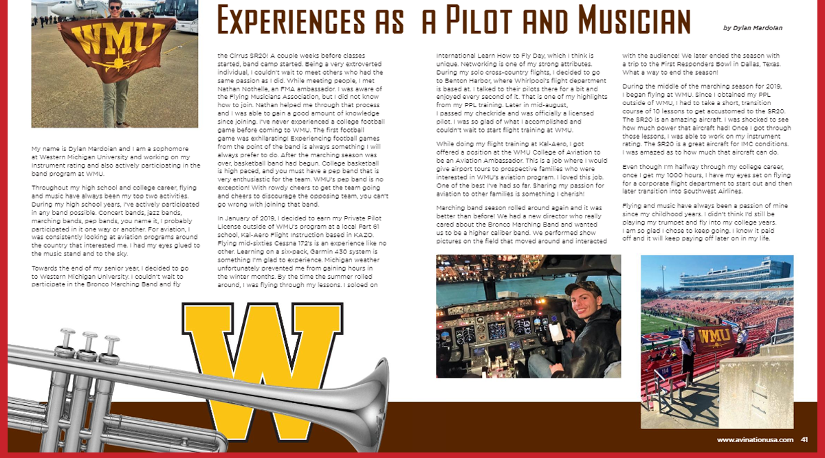
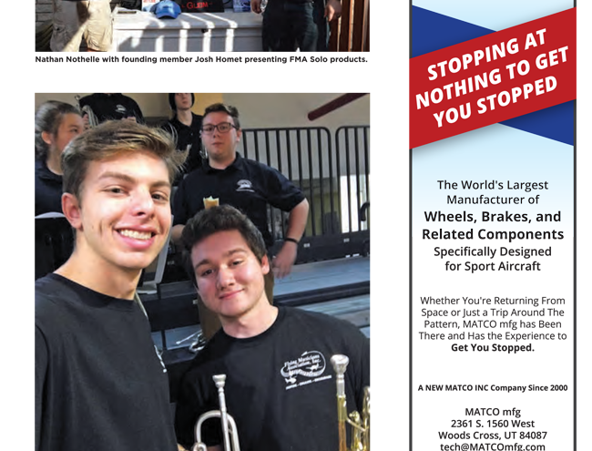

Slide 9
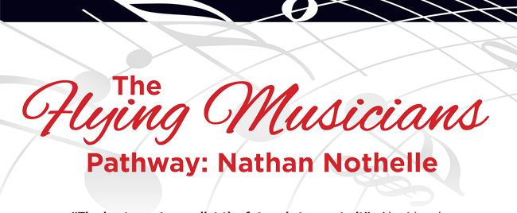
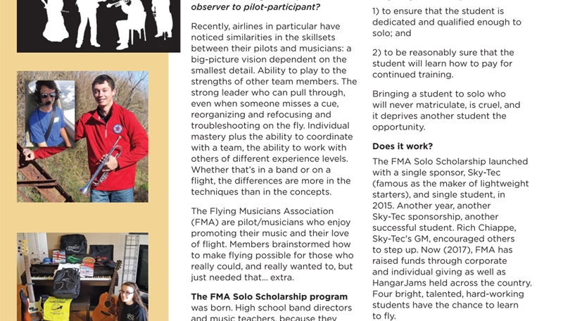
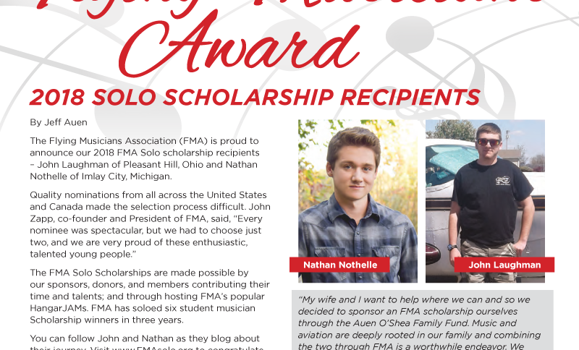
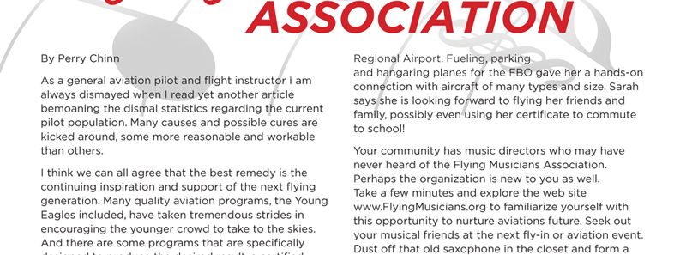

Slide 10
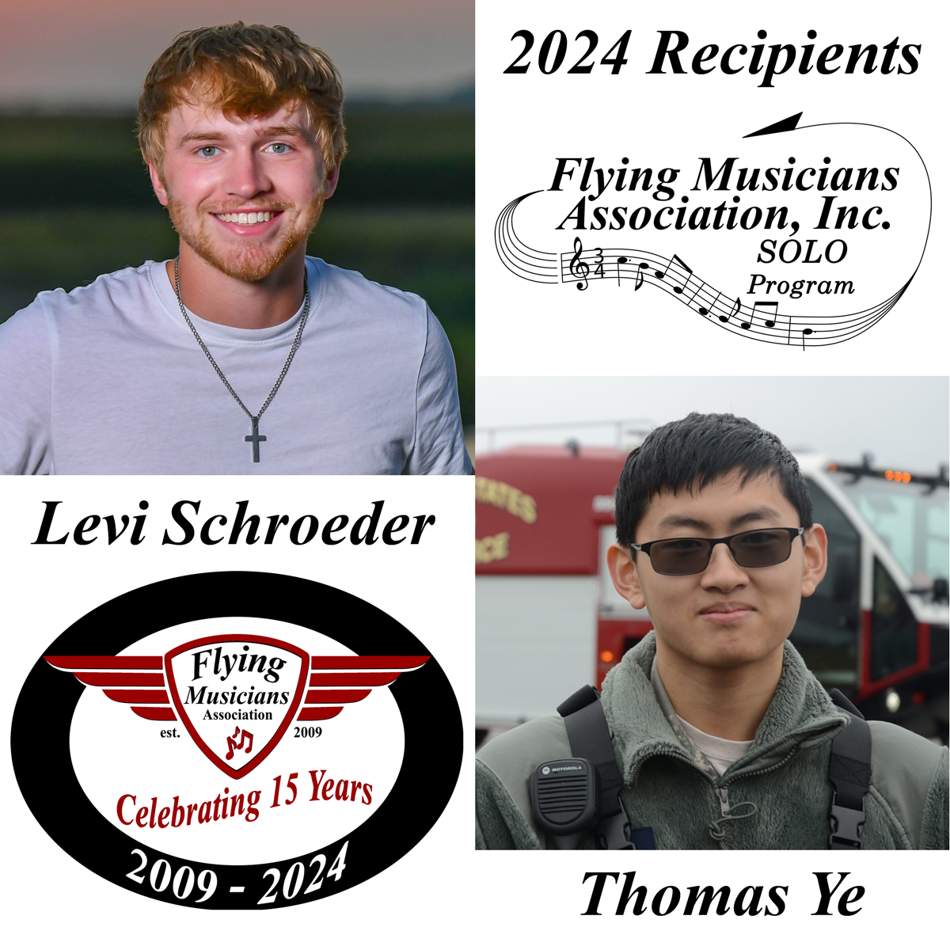

Slide 11
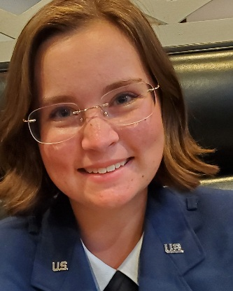
2025 FMA Solo Recipient
Lauren Compton

Slide 12
SPONSORS
121five.com AirTurn *AOPA – Aircraft Owners and Pilots Association AviNation *Barnstorming the Movie *Banterra Aircraft Financing Bose Corporation *Bristell Aircraft USA Capital Music Gear *Cirrus Aircraft Concorde Battery Flying Eyes Optics ForeFlight *Gleim Aviation *Hartzell Engine Technologies LLC *Hartzell Propeller *Heaven’s Landing | Honda Power Equipment *JSfirm.com LAMA – Light Aircraft Manufacturers Association Lockwood Aviation MYGOFLIGHT NBAA – National Business Aviation Association Pacific Coast Jazz / That Other Label *Scheme Designers, Inc. *Seaplane Pilots Association Sensenich Propeller *SiriusXM Sony Pro *Sporty’s Pilot Shop Trade-A-Plane *US Sport Planes Voyage Air Guitars
Sponsors
Asterisks denote Corporate Member too.

Slide 13
Thank You for Spreading the Word
AviNation
AVweb
EAA Sport Aviation
GAnews
121five
AOPA Pilot
Midwest Flyer
Commemorative Air Force
Flying Magazine
Making Music Magazine
Canadian Aviator
Contact Magazine
Trade-A-Plane
AirFactsJournal
Global Air
State Aviation Journal

Slide 14


Slide 15
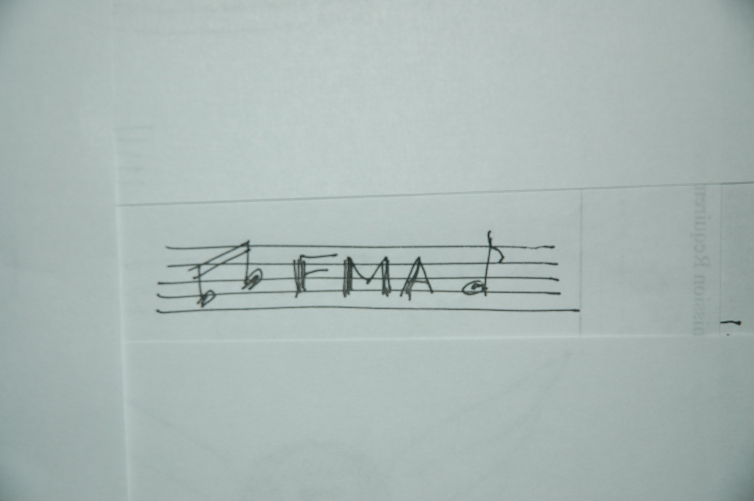
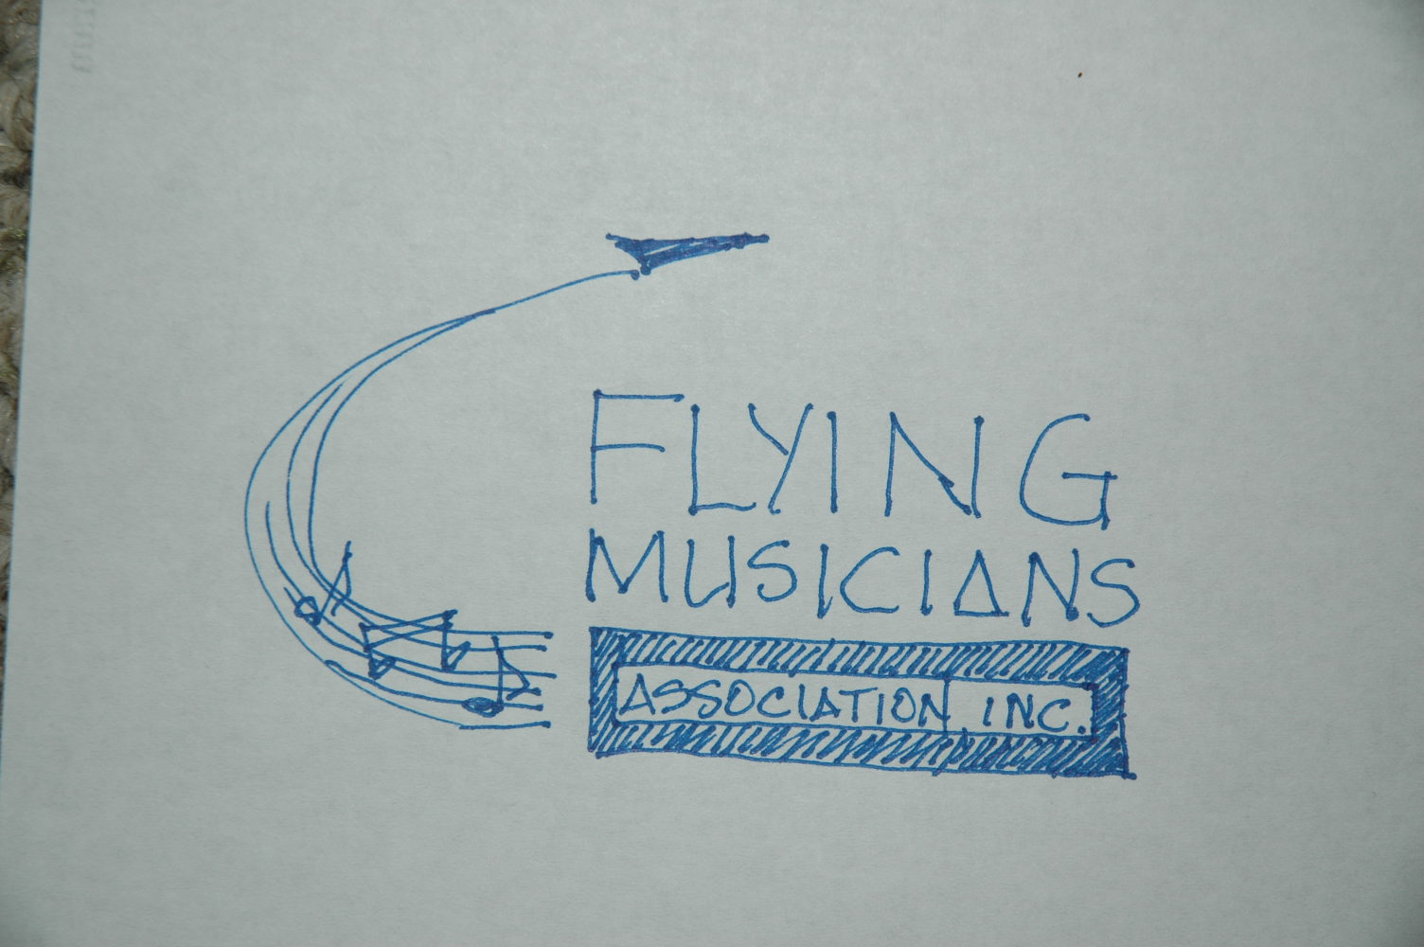
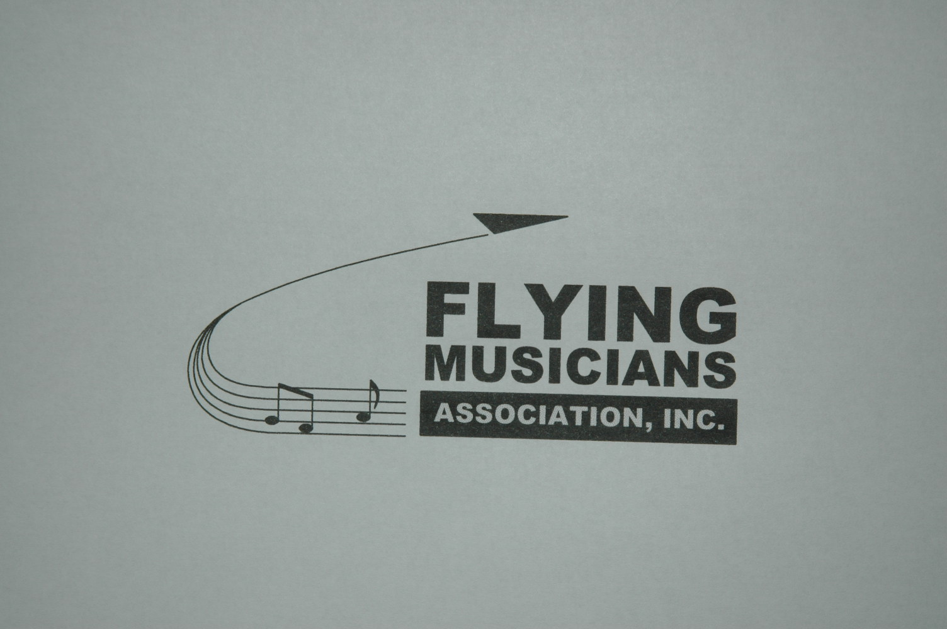
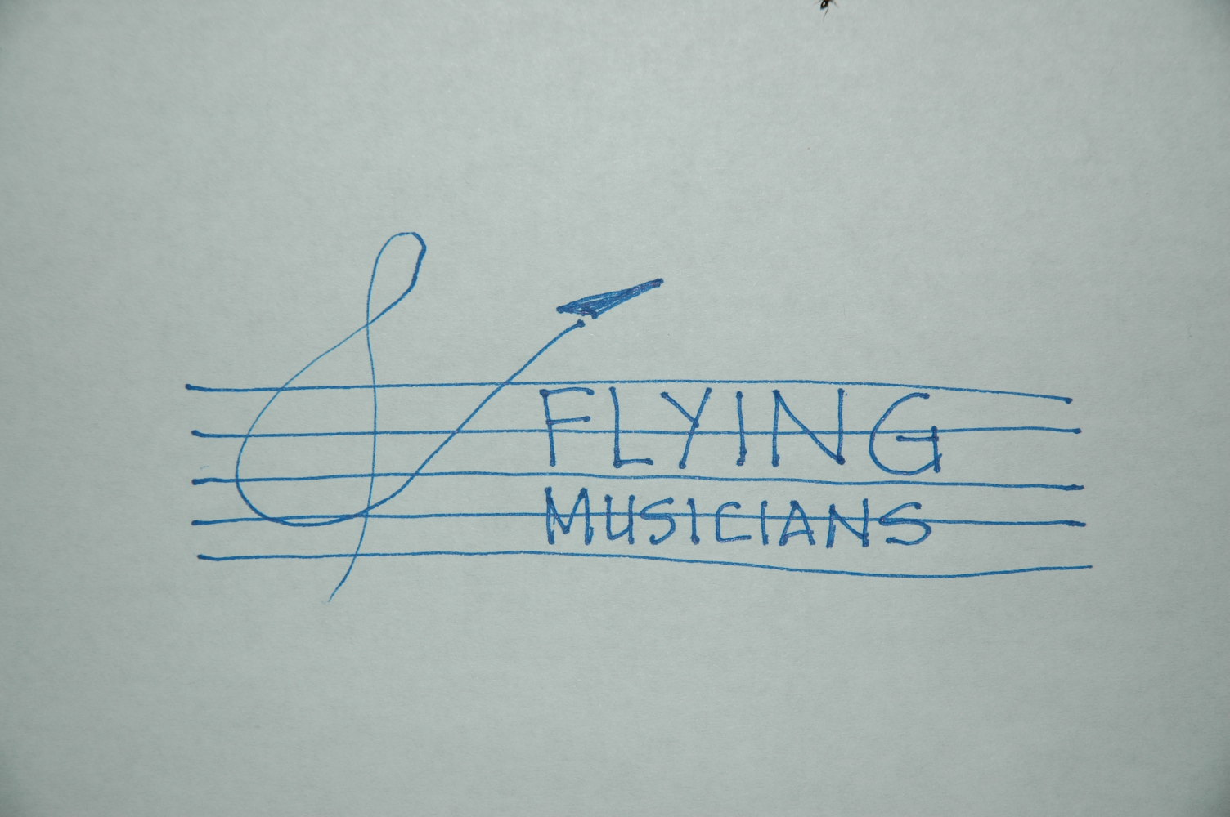
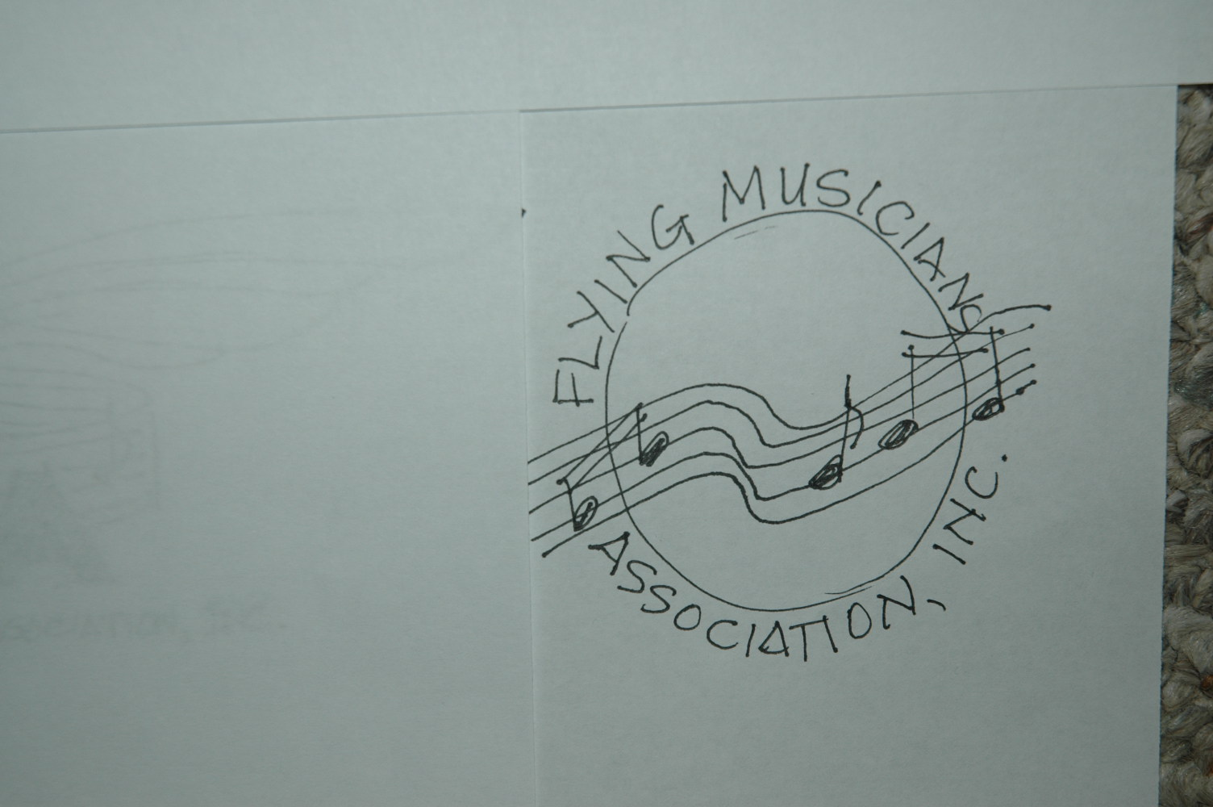
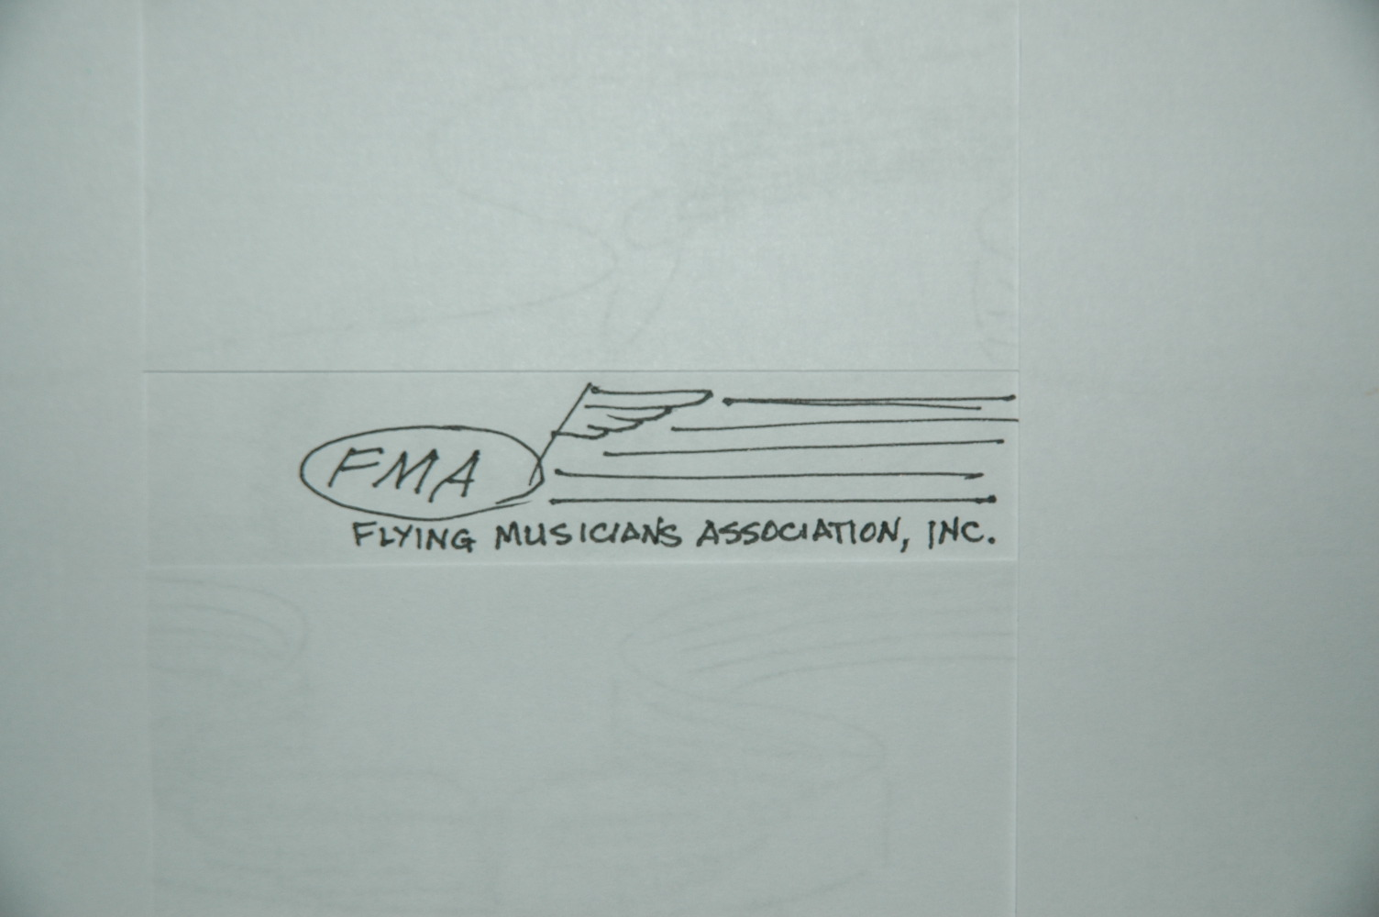
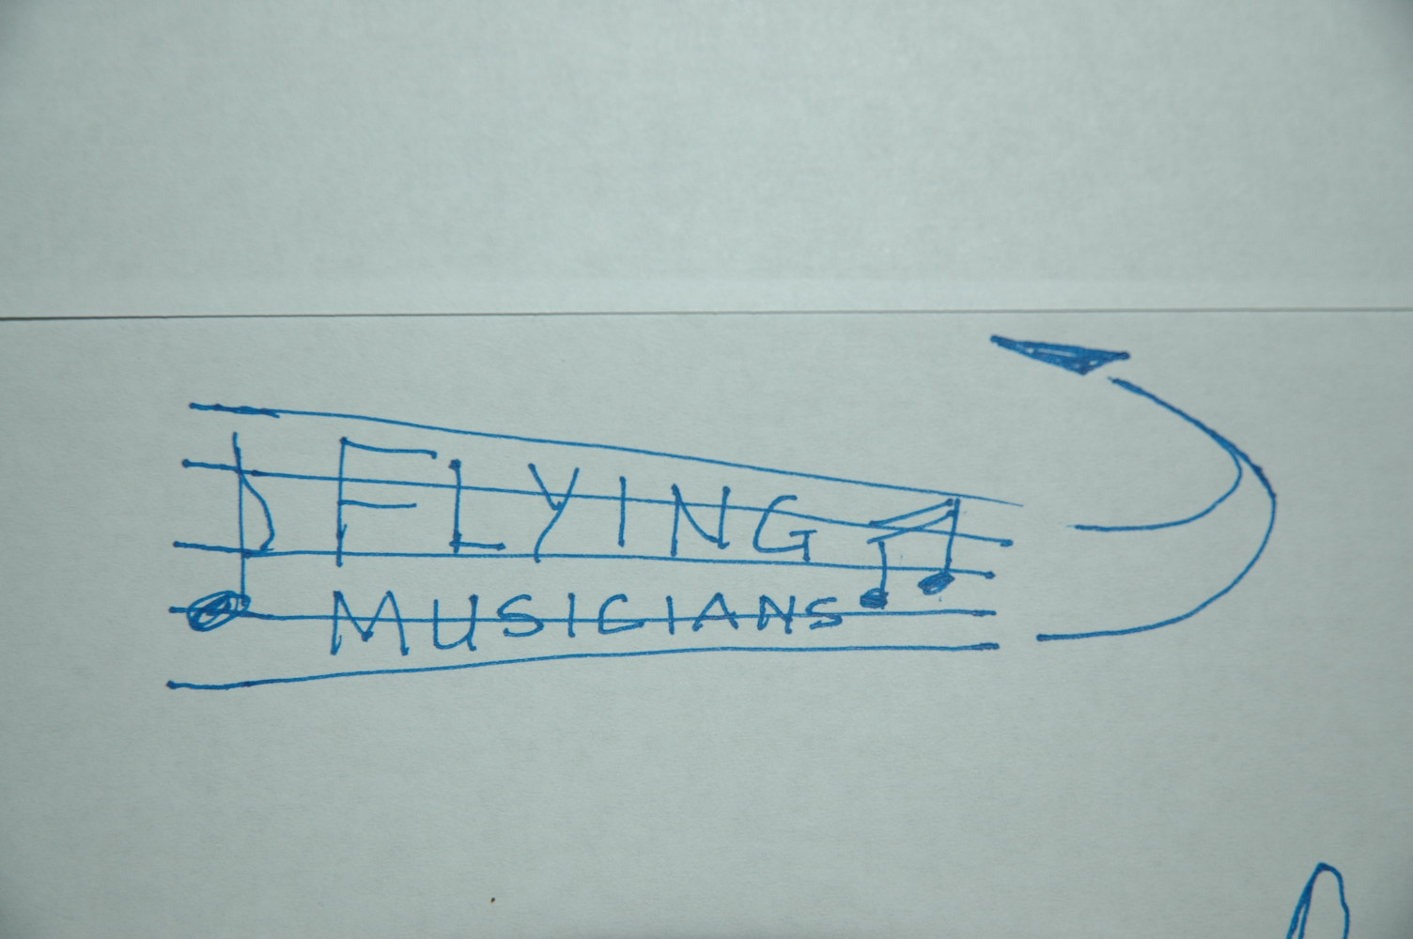
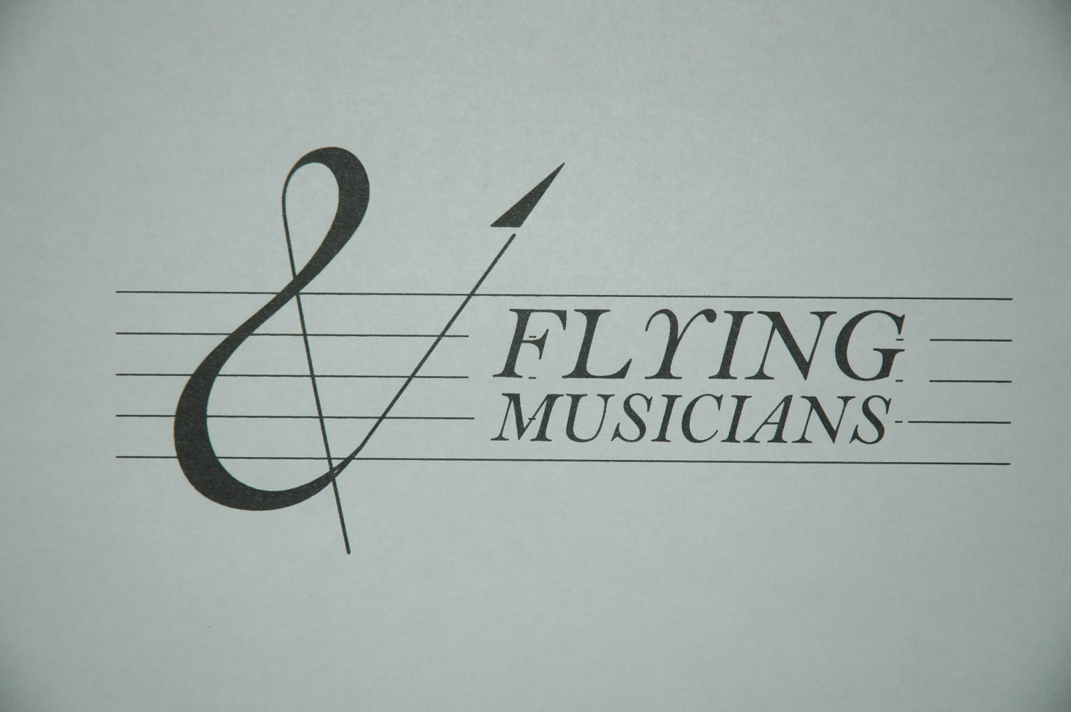
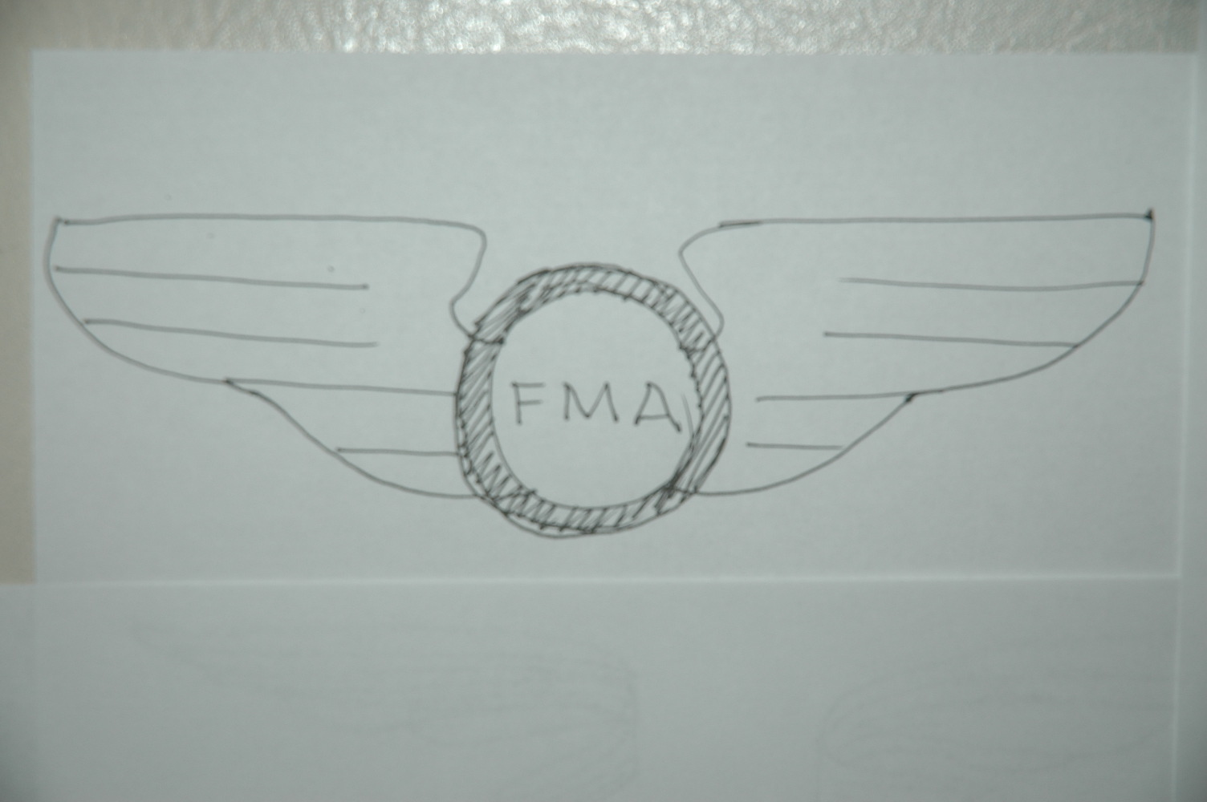
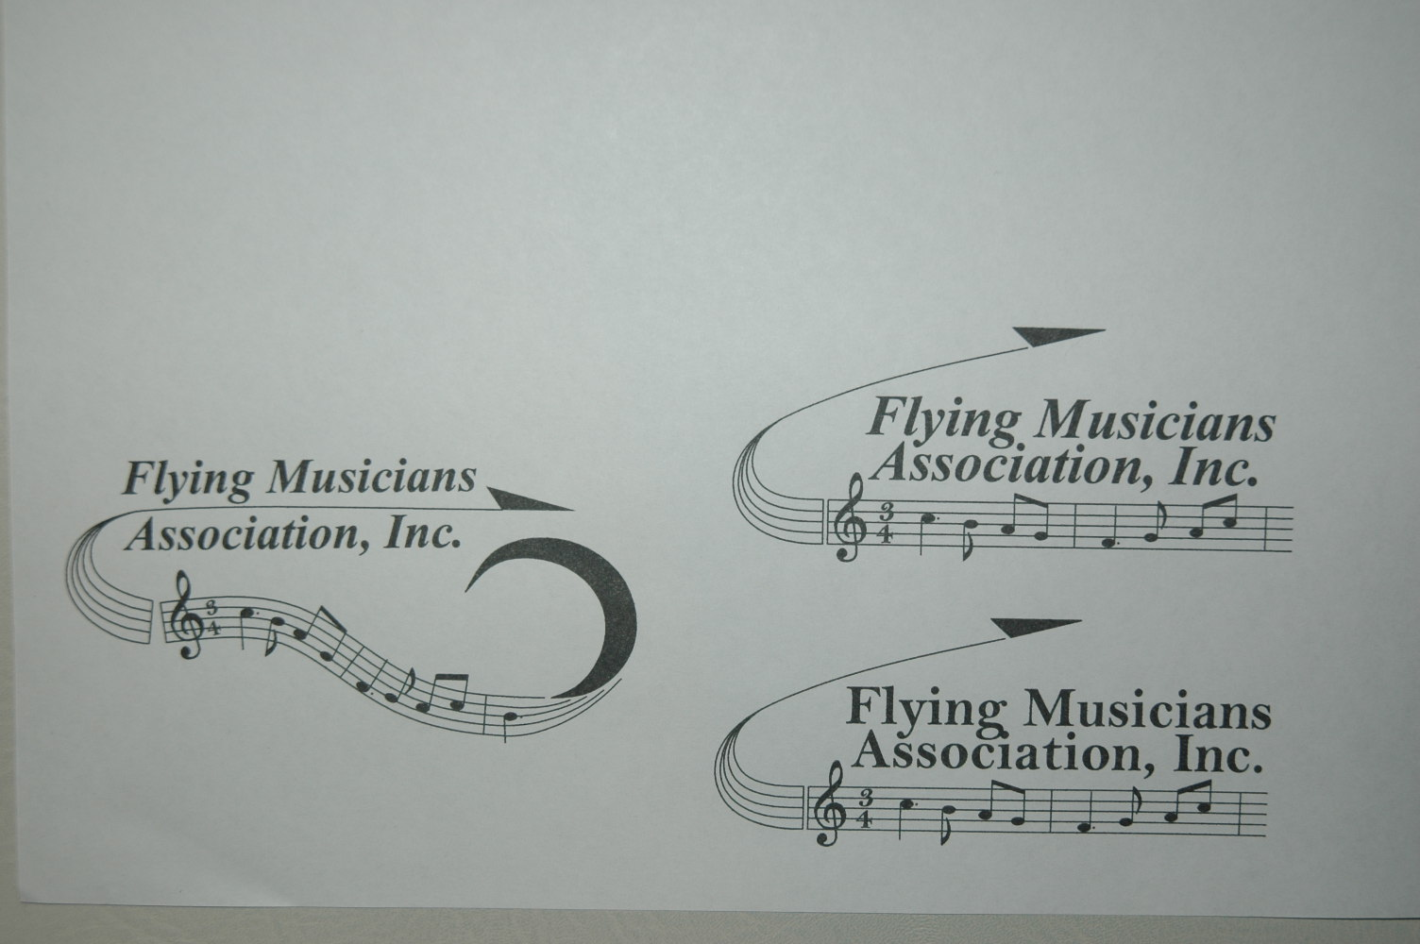
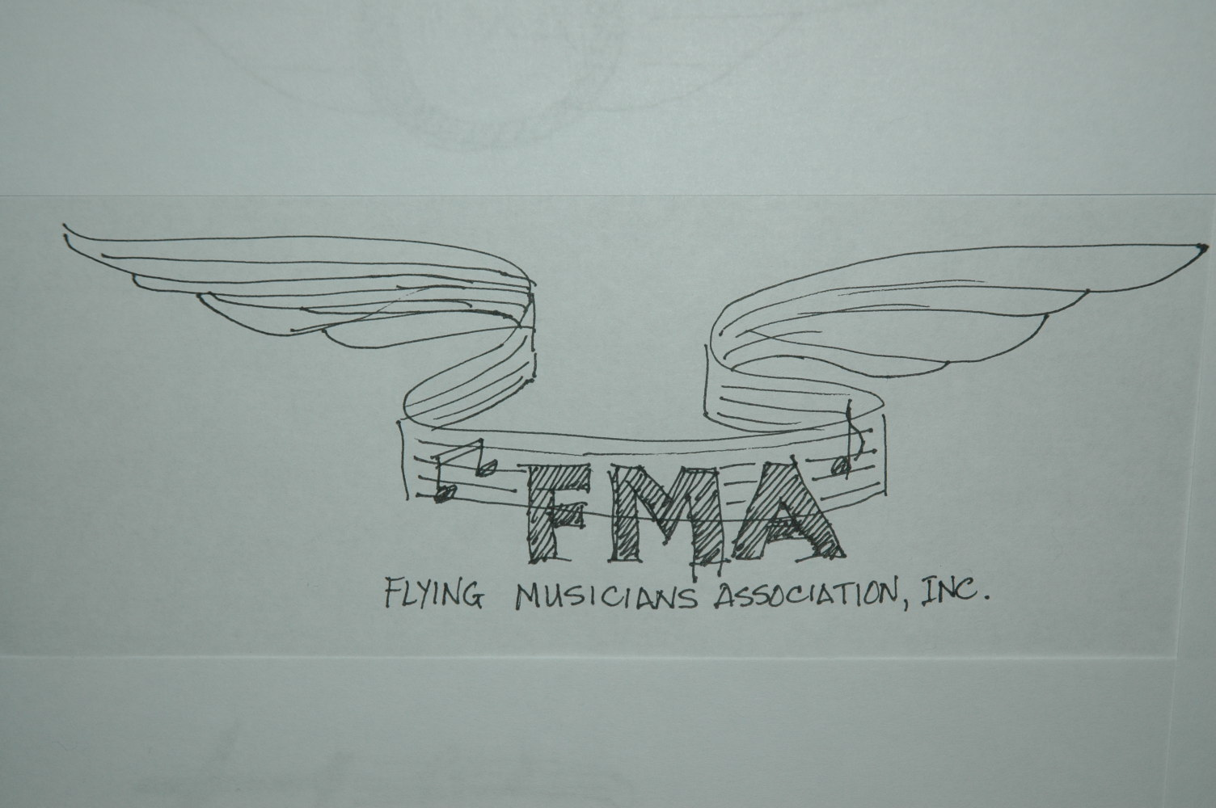
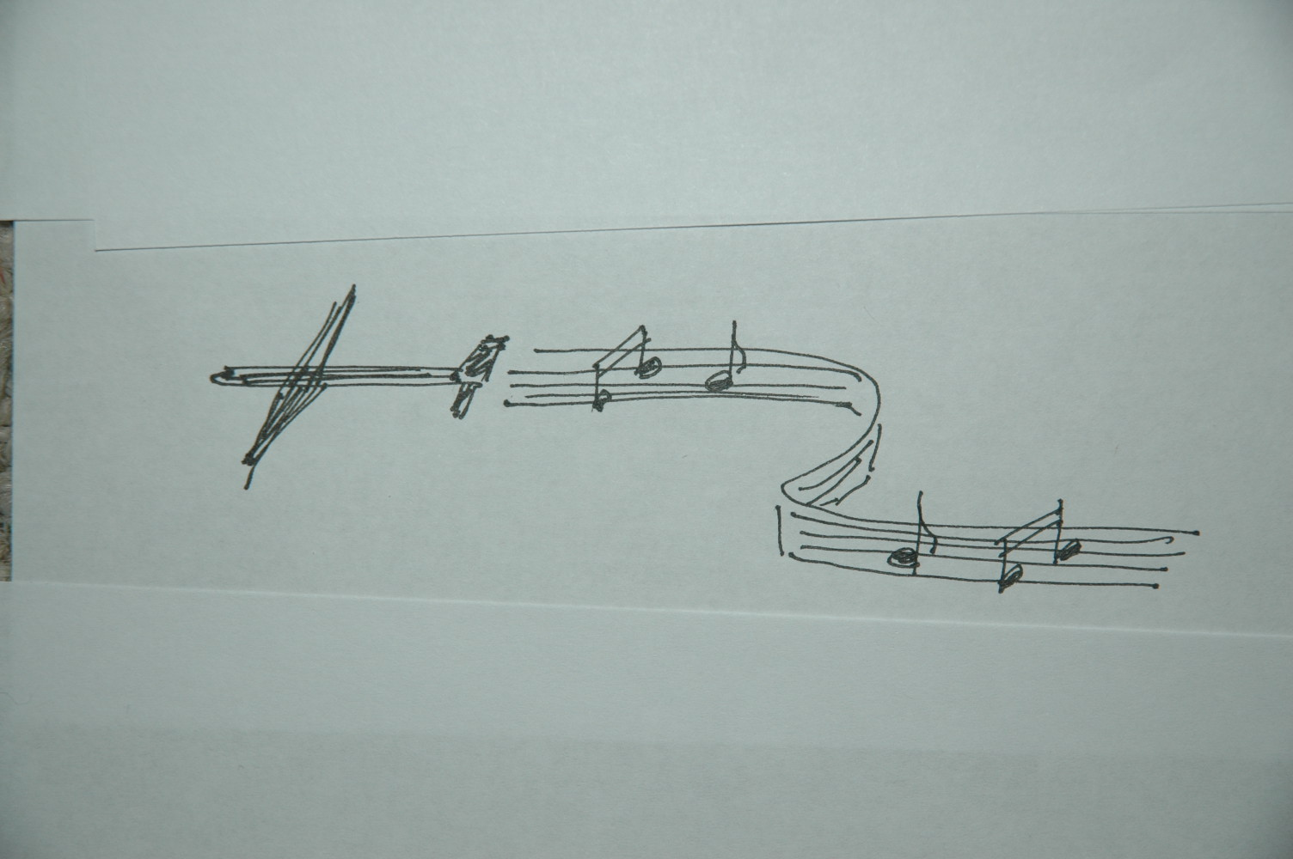

Slide 16



Slide 17


Slide 19
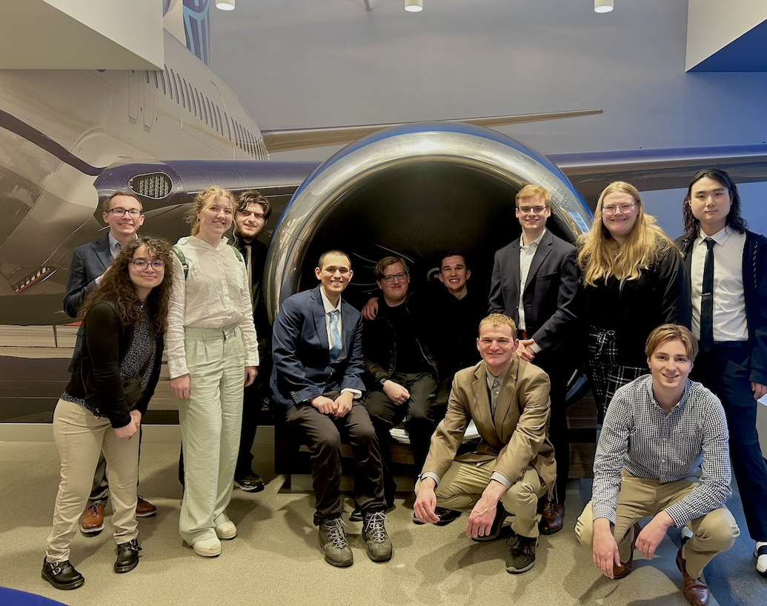
UND FMA Chapter
2025

