Slide 1
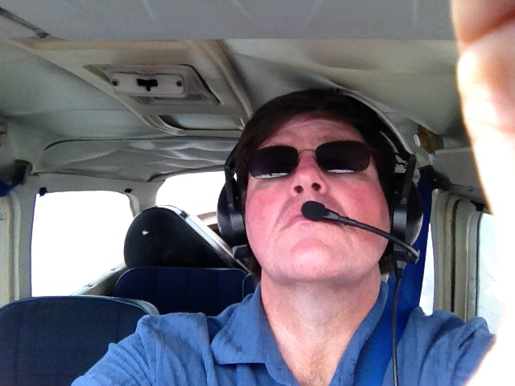
Music In The Skies
What Pilots Can Learn
From Musicians
Jay Mason, ATP, CFI-AMEI

Slide 2
About Your Presenter:
Jay Mason: Pilot
2nd Generation GA Pilot: Dad earned his Private Pilot's license in 1964, and his Instrument Rating in 2000 (Jay was his CFII), and accumulated over 500 hours TT.
Earned Private Pilot in 1988, CFI in 1993
ATP multi-engine with commercial single-engine. Flight Instructor for Airplanes, Single and Multi-Engine Land, and Instrument Airplane
5000 + hours TT, 3800+ hours dual given. Gold Seal CFI
American Bonanza Society Flight Instructor Academy Graduate
Owned a Mooney M20B and a Piper Turbo Twin Comanche
FAASTeam Representative, LGB FSDO

Slide 3
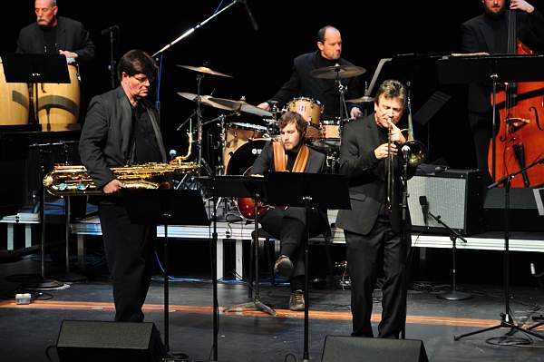
Jay Mason: Musician
Credits: Secret Life of Pets; Frozen & Frozen 2; Toy Story 3; Sponge Bob Movie; America's Funniest Home Videos theme; Gilmore Girls; Tonight Show; Michael Buble'; Michael Feinstein; Seth McFarlane; American Dad; Grammy Award Winner
Faculty member at CSU, Long Beach Cole Conservatory of Music, and Concordia University, Irvine

Slide 4
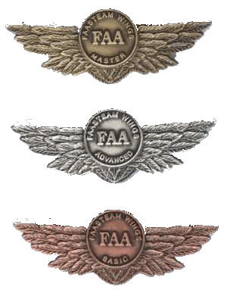
The Wings Program
Recurrent Training for GA pilots
Targeted toward the issues that are proven to cause trouble
Flexible: changes to reflect the latest information
Managed by YOU!
Replaces the Flight Review
Helps you be a better, safer, pilot

Slide 5

The FAASTeam
The Educational Outreach arm of the FAA
Local, volunteer, pilots, Flight Instructors, others
Facilitates the Wings program

Slide 6
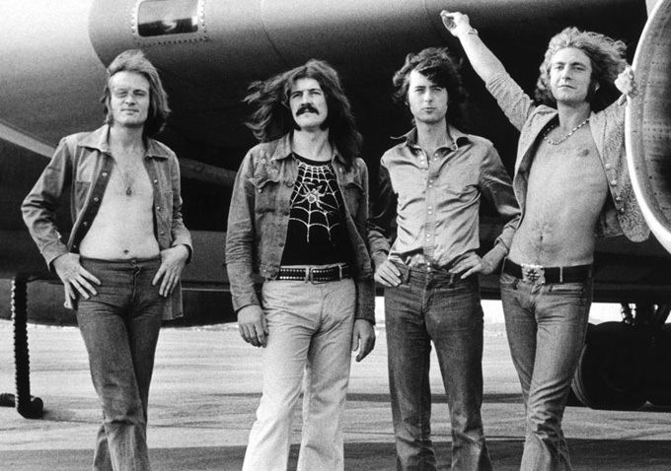
Notes:
Led Zeppelin on tour, in front of their B707 in 1973.

Slide 7
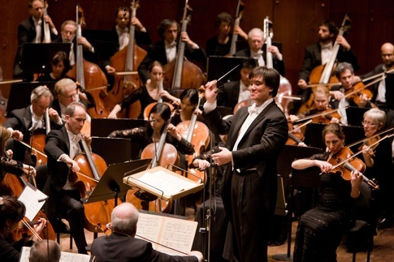
Notes:
Typical musicians at their best, or at least what we’d like to think of those whom we might learn something from (!)

Slide 8
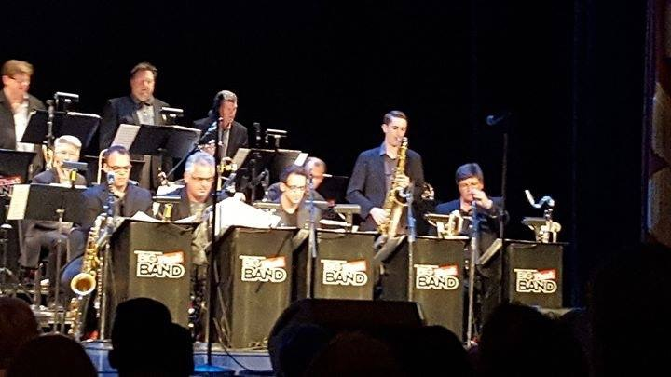
Gordon Goodwin's Big Phat Band, live at SF Jazz Festival
6/11/2016

Slide 9

Notes:
Alex Lifeson, guitarist for the band Rush. Play YYZ from Rush

Slide 10
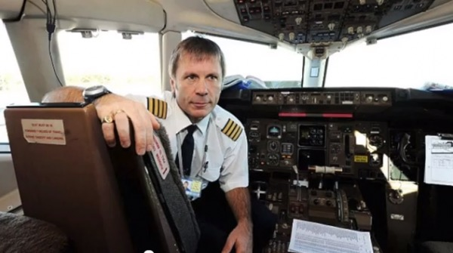
Notes:
Bruce Dickinson, B747 Captain

Slide 11

Notes:
Bruce Dickinson, lead singer with Iron Maiden, out of the B747 cockpit!! Play Aces High from Iron Maiden…This is your Captain Speaking…

Slide 12
MUSICIANS WHO ARE PILOTS
Bruce Dickinson, Iron Maiden
Nick Mason, Pink Floyd
Randy Waldman, MD for Barbara Streisand
Jim Thatcher, French Horn
Jim Self, Tuba from 'Close Encounters'
Jimmy Buffet
Aaron Tippin
Stuart Clark, LA Opera, Studios

Slide 13
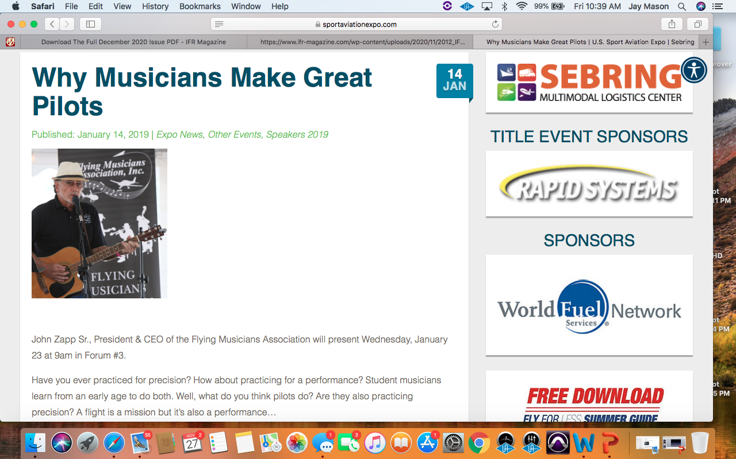
Notes:
Our own John Zapp (and many others!) discussing the relationship between musicians and pilots

Slide 14


Slide 15
"Since flying is a form of self-expression, it may be compared to another form-music. A music teacher can teach the fundamentals, show students how to read music, but cannot teach them how to play the piano. The instructor can only guide; learning to play must come from a student's motivation and desire to acquire the skill, and success comes in direct relation to the amount of effort put forth to achieve it."
Jim Webb, Flying The Wing

Slide 16
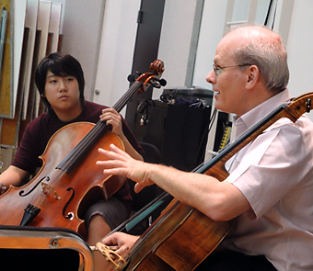
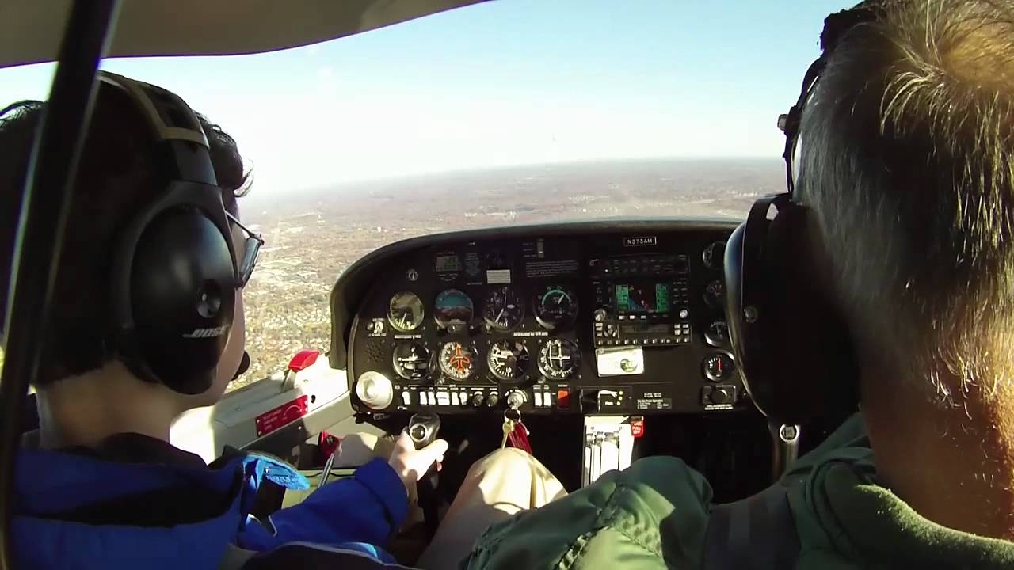
MOTIVATION
Notes:
Why do you want to do this? Why do you want to perform at a certain level? Perfection never happens, but excellence can and is required in both disciplines. The teacher only guides-if the pilot has motivation and aspires to a high form of self-expression, as do many artists, they can make their flying like a musical performance.

Slide 17
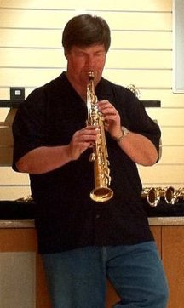
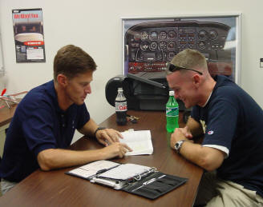
DISCIPLINE

Slide 18
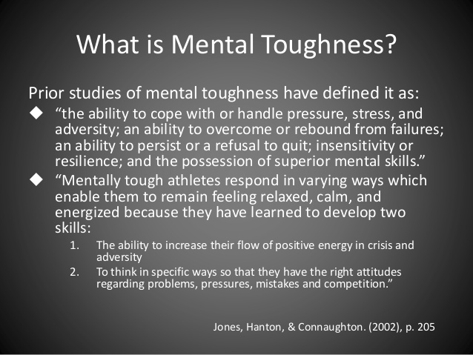
Notes:
For musicians, mental toughness often involves recovering from mistakes, not psyching yourself out, etc. For pilots, it can be responding to emergencies, to abnormal situations, unexpected weather.

Slide 19
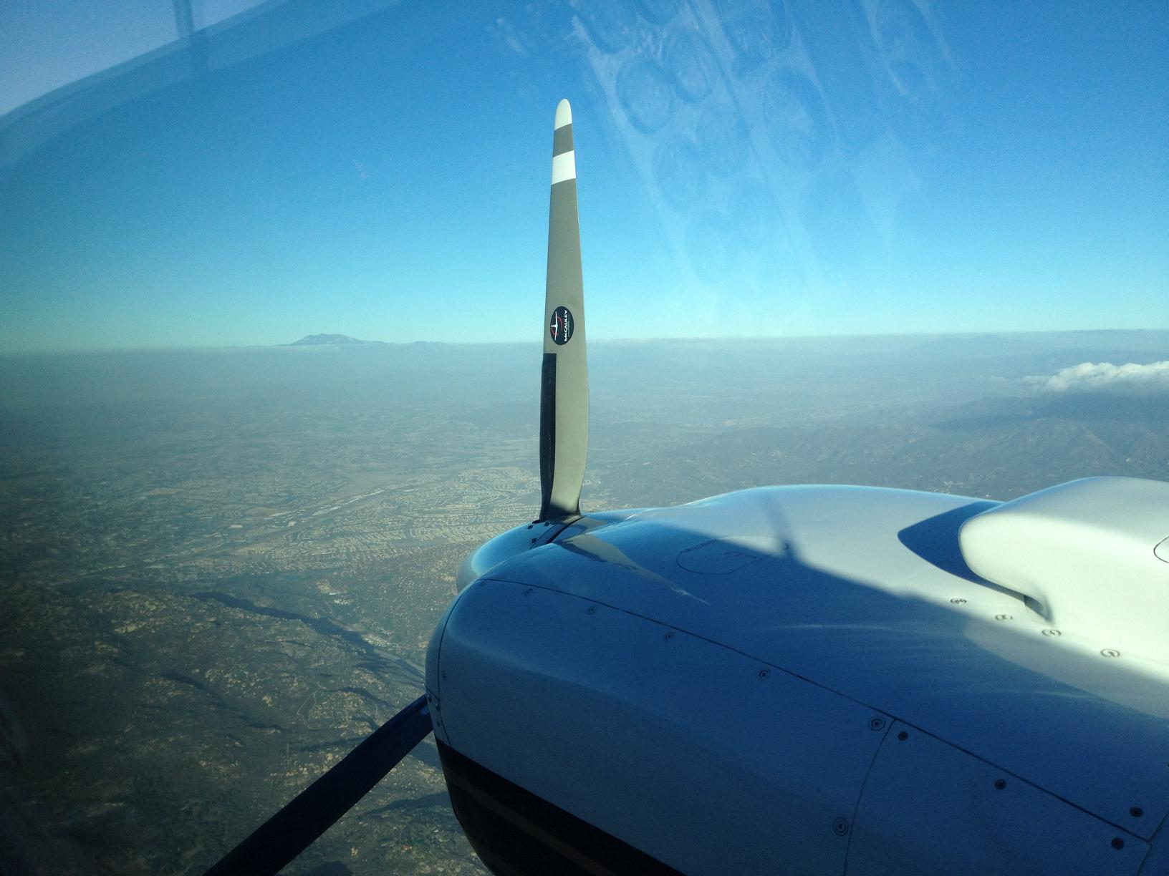
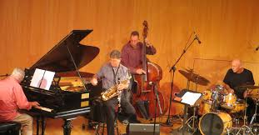
THINKING ON ONE'S FEET (IMPROVISING)

Slide 20
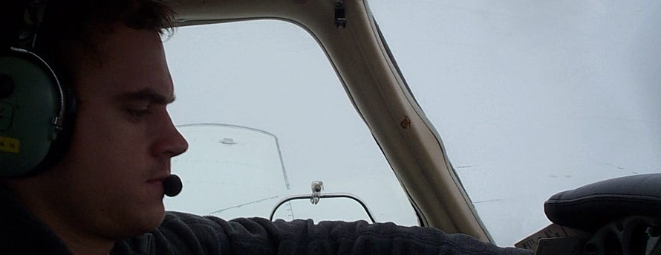
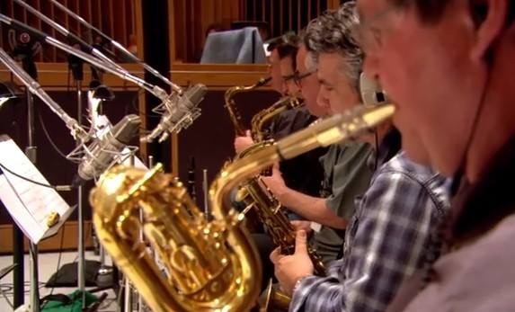
FOCUS, LIVING IN THE MOMENT

Slide 21
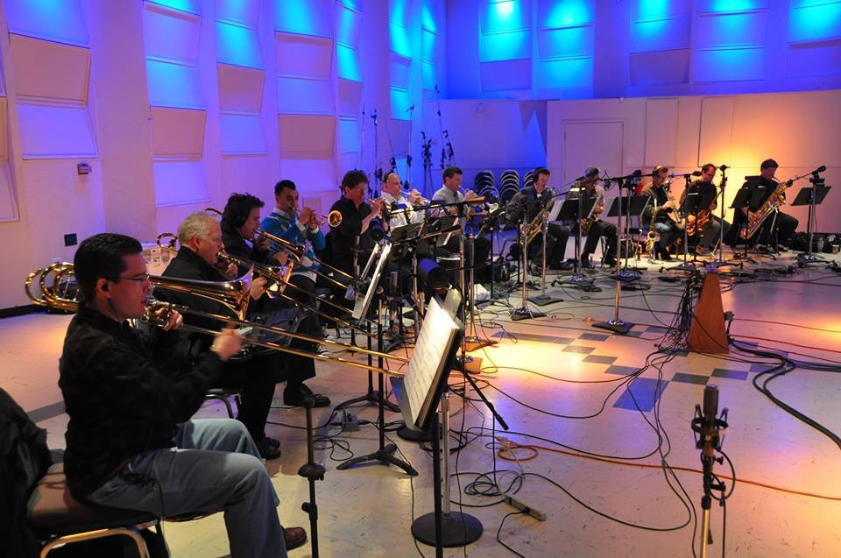
"it's not that pilots have poor procedures, it's that most pilots have no procedures at all." Richard Collins
FOCUS-BE IN THE MOMENT
Notes:
These musicians are focused. Oftimes people observing musicians performing or recording will comment that a bomb could go off and they’d keep right on going!

Slide 22

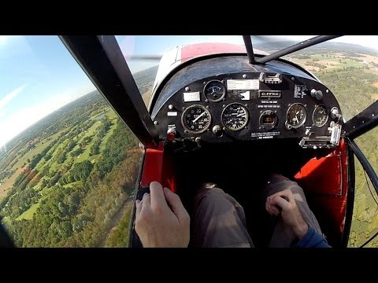
FLYING ARTFULLY

Slide 23
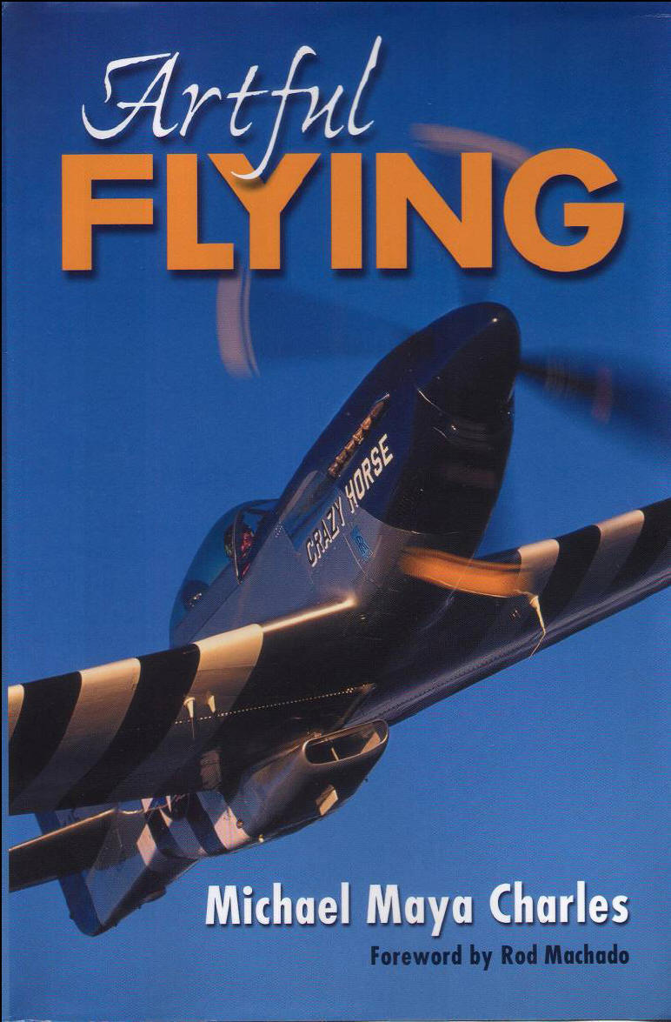
Michael Maya Charles, Artful Flying
Notes:
A must-have text for musicians who are pilots. Many pilots should read and internalize the messages in this book. Read a few choice examples: pp 32-36

Slide 24
Rewards of Artful Flying
1.You will become more aware in your flying
2.Your flying will become smoother
3.Your flying will be safer
4.Your flying will become more interesting
5.Your enjoyment of flying will increase greatly
6.You will discover deeper levels of flying that you didn’t know existed
7.You will be compelled to delve more deeply into your art, compelled to fly more artfully more often
8.You will grow and change in many ways outside the cockpit
9.Your flying will become your life’s work
10. You will begin to recognize your whole life as your art, your masterpiece
INTENTION
Notes:
Artful Flying, page 166

Slide 25
JAY'S iPHONE 'FLYING PLAYLIST'
Come Fly With Me-Frank Sinatra
Learning To Fly-Pink Floyd
If You Were Flying-Patrick Doyle
Flying Over Africa, from "Out Of Africa"-John Barry
YYZ-Rush
Danger Zone, from 'Top Gun'-Kenny Loggins
Fly Away-Lenny Kravitz
Flying, from 'Peter Pan', James Newton Howard
Jake's First Flight, from 'Avatar', James Horner
Leonardo Dreams of His Flying Machine-Eric Whitacre
Defying Gravity, from Wicked
End Credits from 'E.T.', John Williams (a kid flying a bike...
Didn't we all want to do that????)

Slide 26
THANK YOU FOR COMING!
FLY SAFELY!!! HAVE FUN!!!

